Slide 1
Trello-Rest-API
Eng/Omnia salman ibrahem

Slide 2
Table of contents
01
02
What is a REST API
Common HTTP Methods
03
04
Tools for Working with REST APIs
Tools
05
What is Trello
06
Test Case
07
08
Trello Life cycle
Project Demo

Slide 3
What is a REST API
REST API (also called a RESTful API or RESTful web API) is an application programming interface (API) that conforms to the design principles of the representational state transfer (REST) architectural style.
REST APIs communicate through HTTP requests to perform standard database functions like creating, reading, updating and deleting records (also known as CRUD) within a resource.

Slide 4
Common HTTP Methods
GET
POST
Retrieve data from the server.
Create new resources on the server.
PUT
DELETE
PATCH
Update existing resources.
Remove resources from the server.
Partially update resources

Slide 5
Tools for Working with REST APIs
Postman: For testing and exploring APIs.
Swagger/OpenAPI: For documenting REST APIs.
cURL: Command-line tool for making HTTP requests.
Insomnia: Another popular REST client for testing.

Slide 6
Trello and REST API

Slide 7
What is Trello?
What is Trello?
Trello as a popular project management and collaboration tool that helps teams organize tasks using boards, lists, and cards.
Mention its use cases, such as managing projects, tracking tasks, and organizing workflows.
Components
Boards: Trello's main workspace, where projects or tasks are organized.
Lists: Columns that categorize tasks (e.g., "To Do," "In Progress," "Done").
Cards: Individual tasks or items that can be moved between lists.

Slide 8
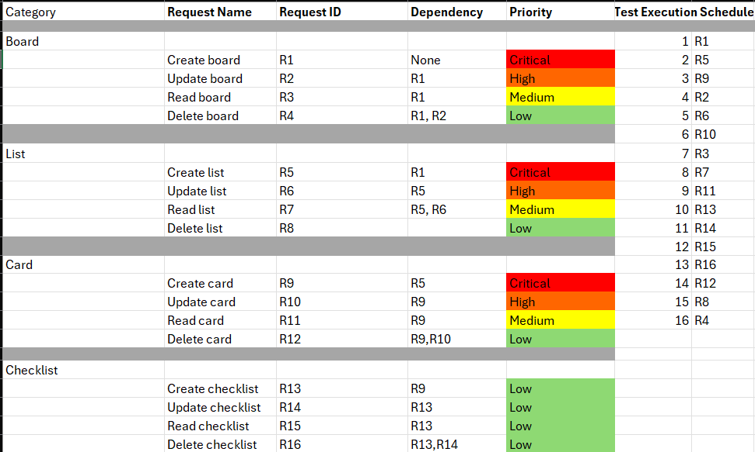
Test Case

Slide 9
Creation Senior
Trello Life cycle
Delete Senior
Create Board
Add a list
Create a Card
Create checklist
Delete checklist
Delete card
Delete list
Delete board

Slide 10
Creation Senior
Trello Life cycle
Delete Senior
Board
List
Cart
Checklist
Cart
Create
Cart
Delete
Create
Cart
Delete
Create
Delete

Slide 11
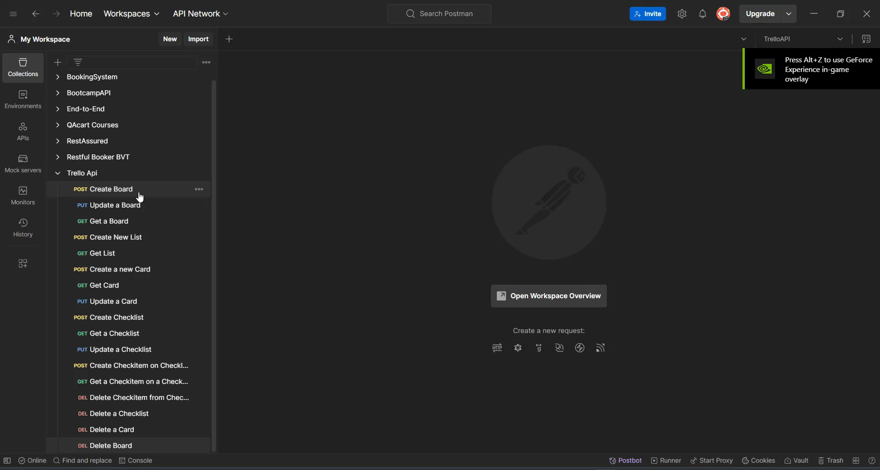
Project Demo

Slide 12
Resources
Trello REST API documentation
Github
Trello Website

Slide 13
Thanks!
Please keep this slide as attribution

